Slide 1
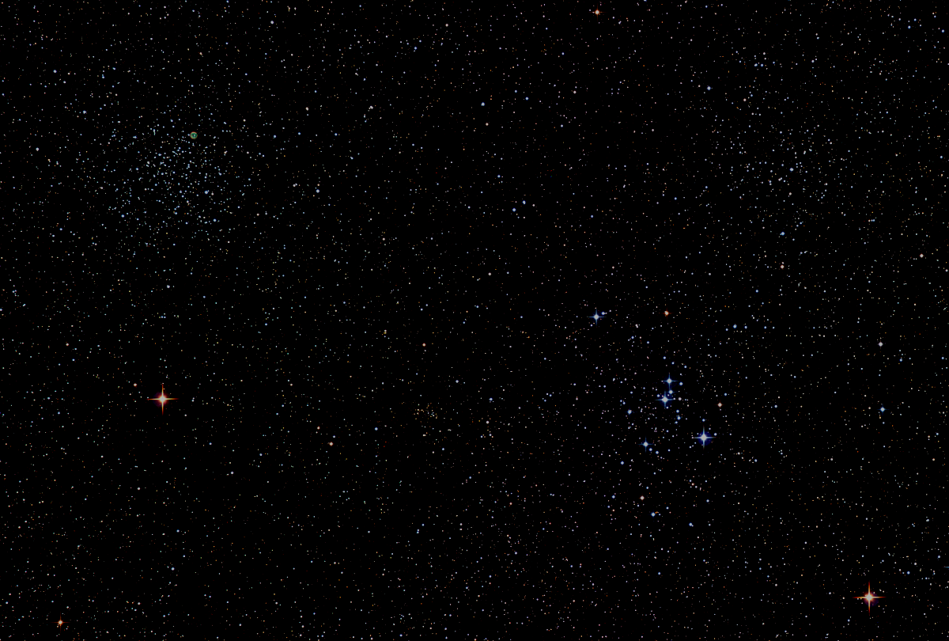

Howard
Astronomical
League
20
July 23, 2020
Notes:
Howard Astronomical League, February 20, 2020

Slide 2
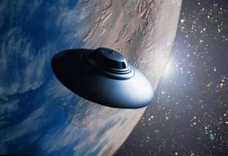
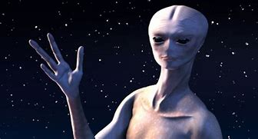
Welcome New Members and Guests

Slide 3
Thank you Joel Goodman
On behalf of the 18,000 members of the Astronomical League, please allow me to congratulate the Howard Astronomical League on winning the Library Telescope drawing for the Mid East Region of the Astronomical League.

Slide 4
Membership
Our Membership in HAL has grown by at least 13 new members this month. Our FaceBook membership is also growing as well as our Impromptu list.

Slide 5
Impromptu Star Parties
Alpha Ridge is open for a keyholder to call an Impromptu with the following provisions:
1) HALO will remain closed, except to the keyholder to turn off/on the parking lot and restroom lights and to turn on power to the exterior SE corner of HALO.
2) The restrooms will not be unlocked. If they are left unlocked by the County, they are not to be used.
3) The keyholder is responsible for closing the gate after entering and keeping lock separately until locking up at the end of the observing session.
4) Members will be informed that the gate is being left closed except for entry and exit. Members will be asked to open the gate inwards and close the gate behind them upon arrival and to repeat the routine upon departure.
5) Members will be reminded that all social distancing protocols currently called for in Howard County will be in effect.

Slide 6
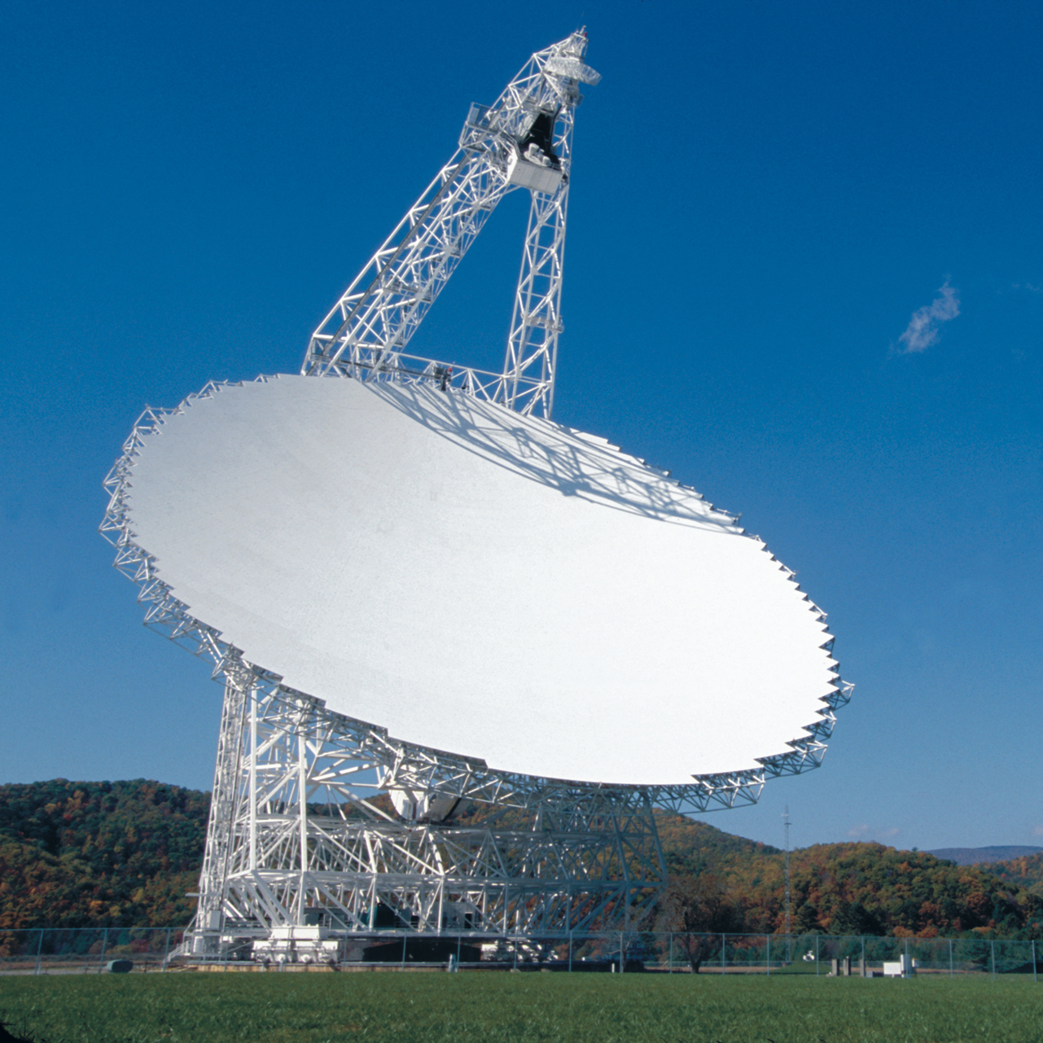
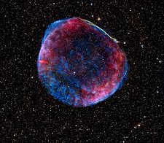
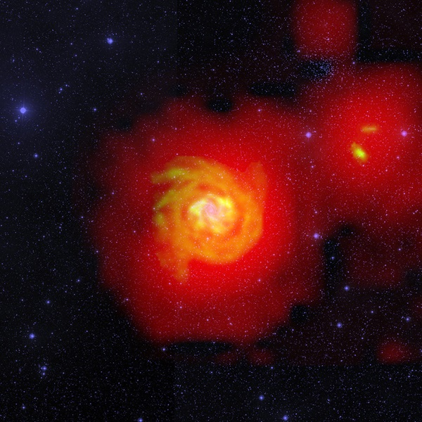
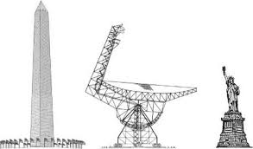
August Guest Presenter
August 20, 2020
Sue Ann Heatherly
Senior Education Officer
Green Bank Observatory

Slide 7
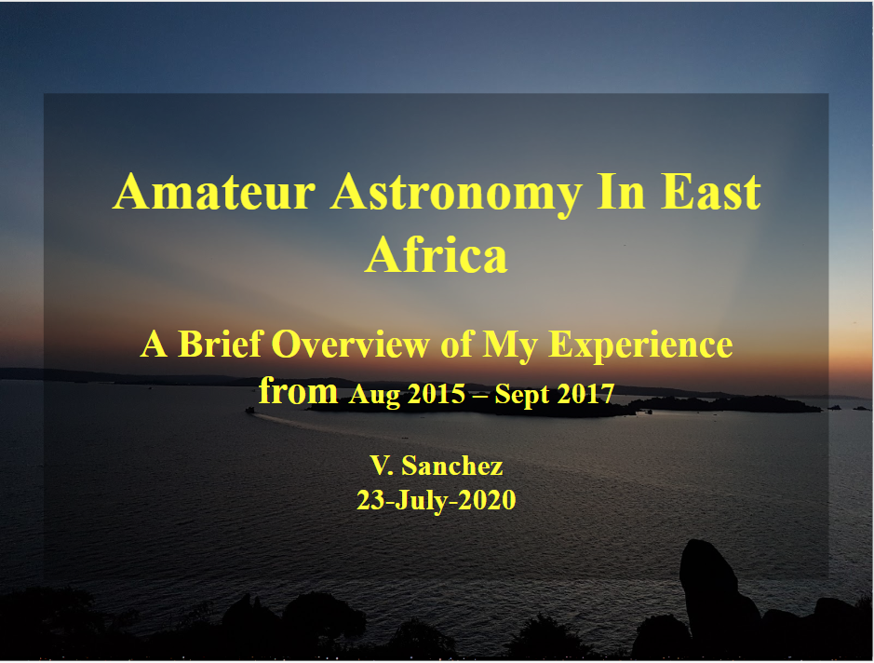

Slide 8
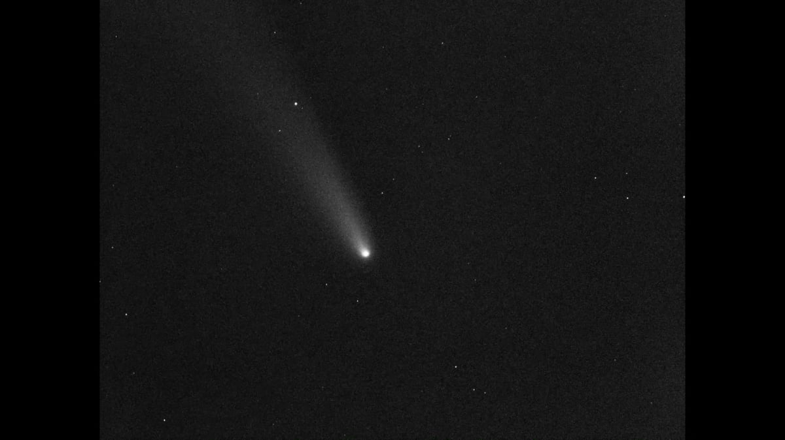

https://vimeo.com/439706089?utm_source=email&utm_medium=vimeo-cliptranscode-201504&utm_campaign=28749
Bill

Slide 9
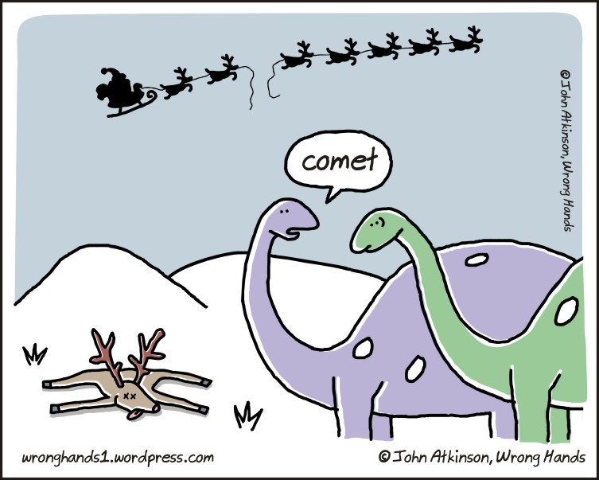
Astro Humor

Slide 10
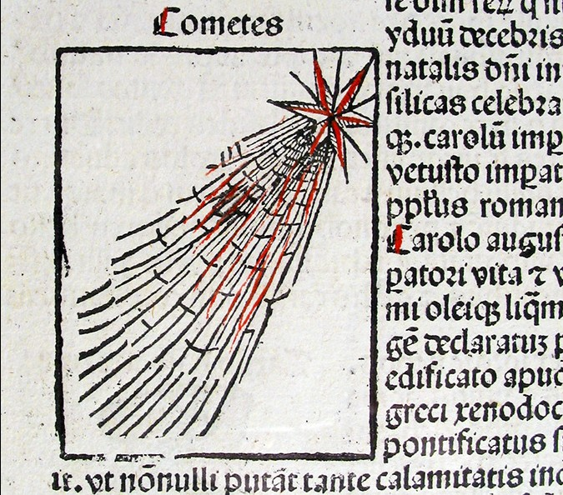
The oldest picture of a comet is that of Halley's Comet in the Nuremberg Chronicle for AD 684.

Slide 11
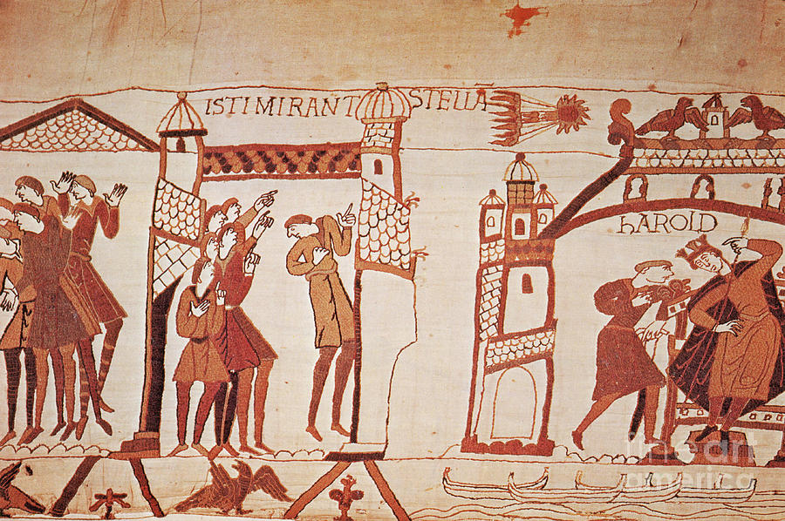
One very famous recording of a comet is the appearance of Halley's Comet as a terrifying omen on the Bayeux Tapestry, which records the Norman conquest of England in AD 1066.

Slide 12
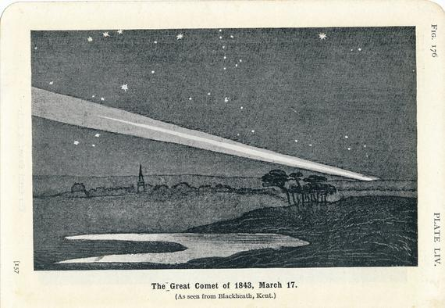

Slide 13
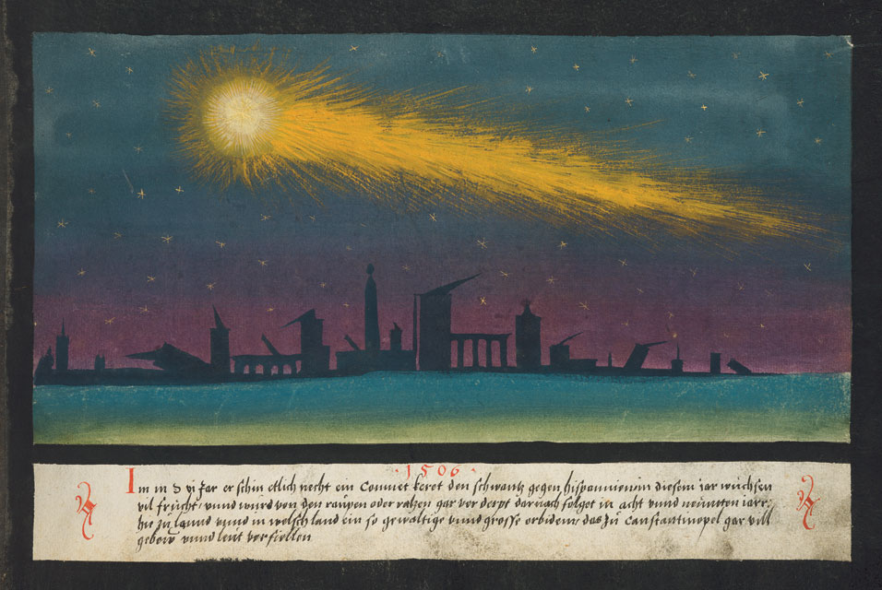
The Book of Miracles (Augsburg, 16th century)

Slide 14
What is a Comet?
A comet is an icy, small Solar System body that, when passing close to the Sun, warms and begins to release gases, a process called outgassing. This produces a visible atmosphere or coma, and sometimes also a tail. These phenomena are due to the effects of solar radiation and the solar wind acting upon the nucleus of the comet. Comet nuclei range from a few hundred meters to tens of kilometers across and are composed of loose collections of ice, dust, and small rocky particles. The comet may be up to 15 times Earth's diameter, while the tail may stretch one astronomical unit. If sufficiently bright, a comet may be seen from Earth without the aid of a telescope and may subtend an arc of 30° (60 Moons) across the sky. Comets have been observed and recorded since ancient times by many cultures.

Slide 15
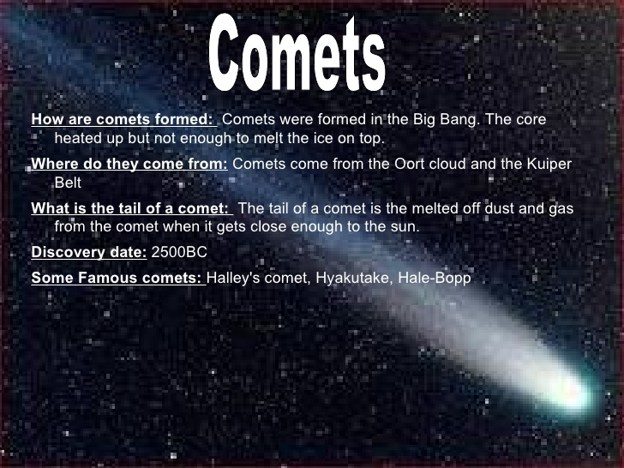
How are Comets Formed?

Slide 16
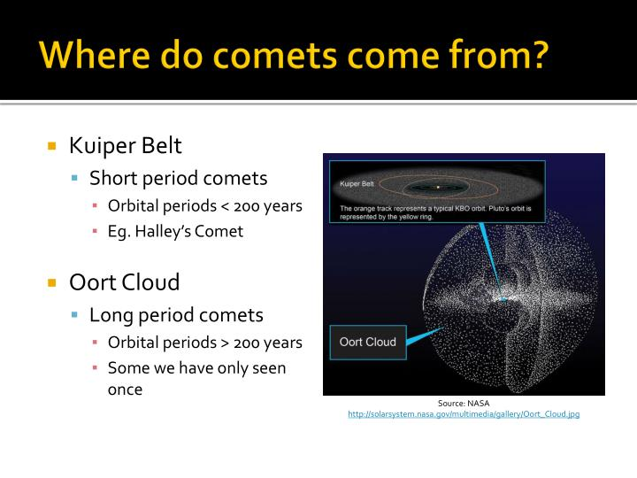
Comets are believed to have two sources. Long-period comets (those which take more than 200 years to complete an orbit around the Sun) originate from the Oort Cloud. Short-period comets (those which take less than 200 years to complete an orbit around the Sun) originate from the Kuiper Belt.

Slide 17
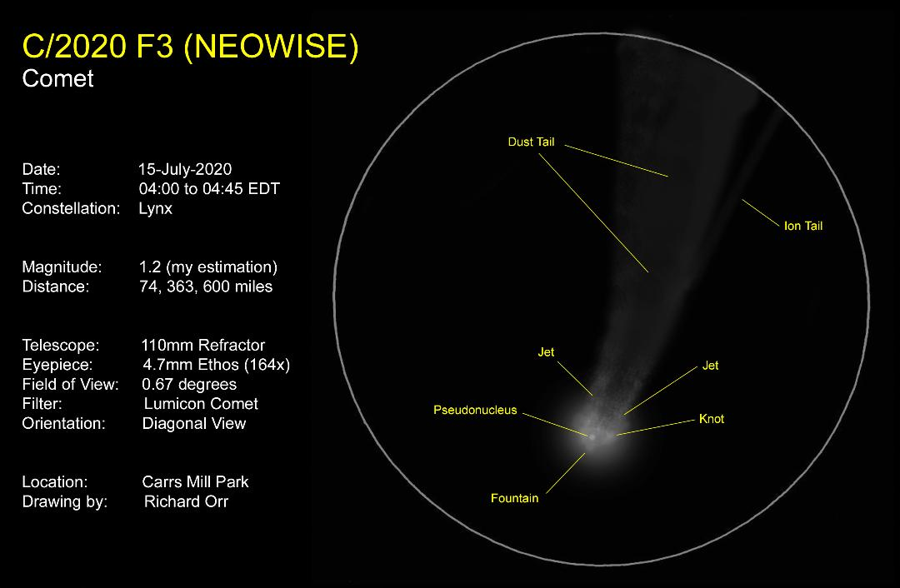
Richard Orr

Slide 18
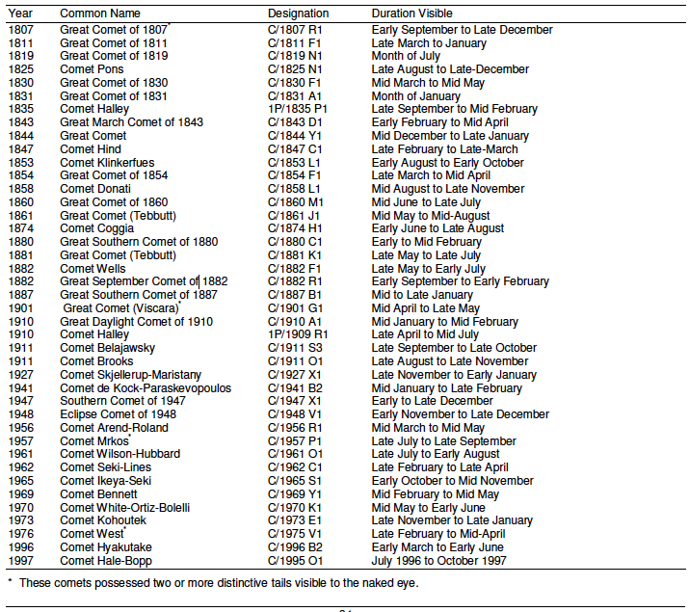
Historical List of Comets

Slide 19
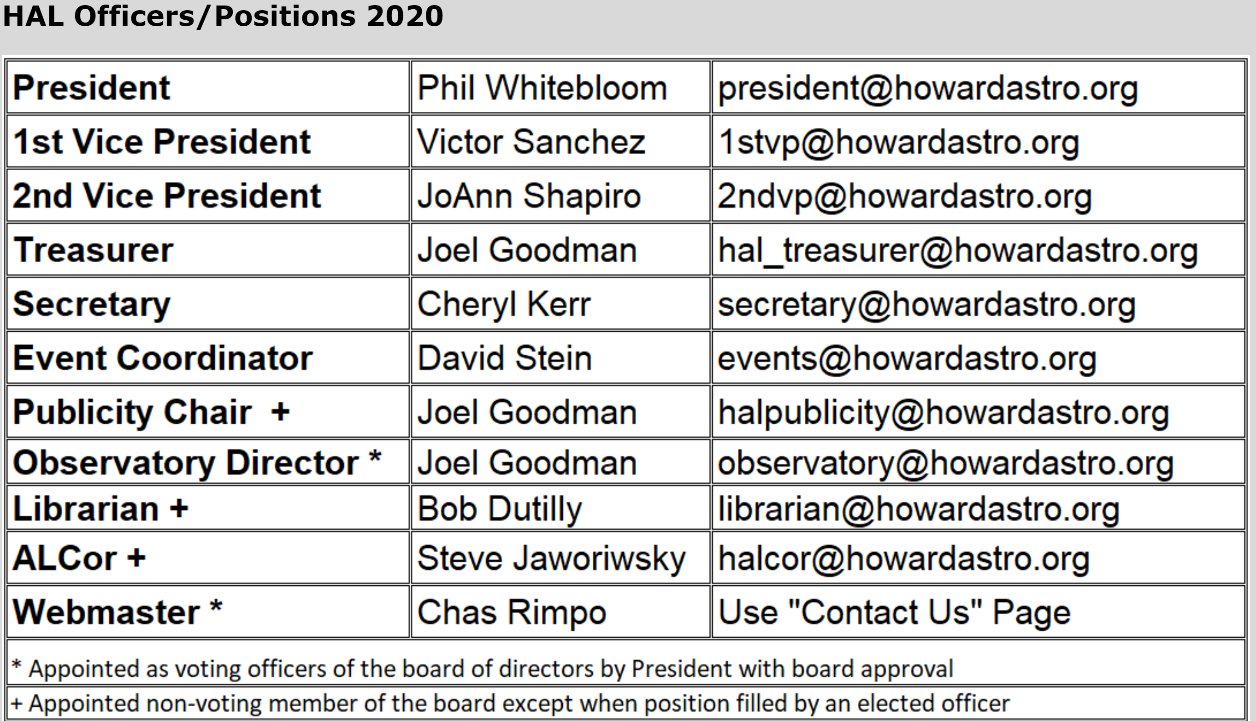
HAL OFFICERS

Slide 20

HAL Virtual
What’s Been Happening?

Slide 21
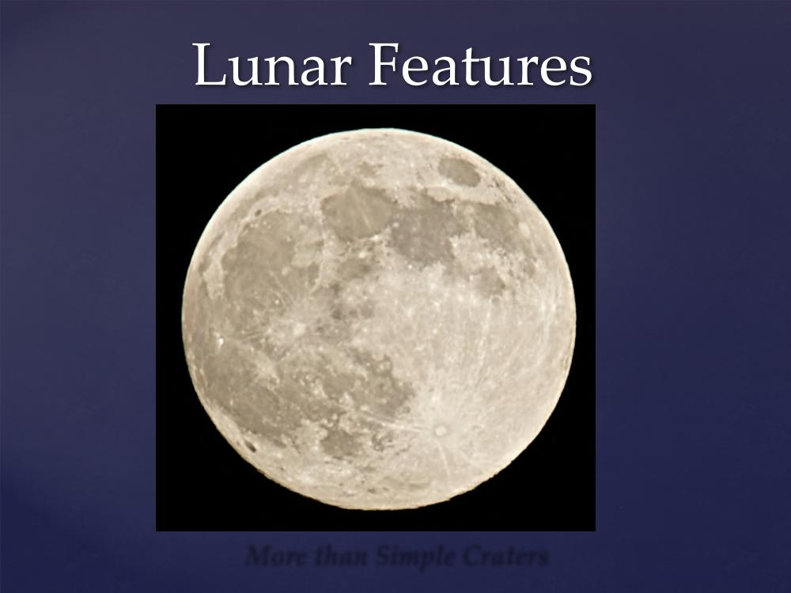
Astro-School Virtual
Steve Berte

Slide 22
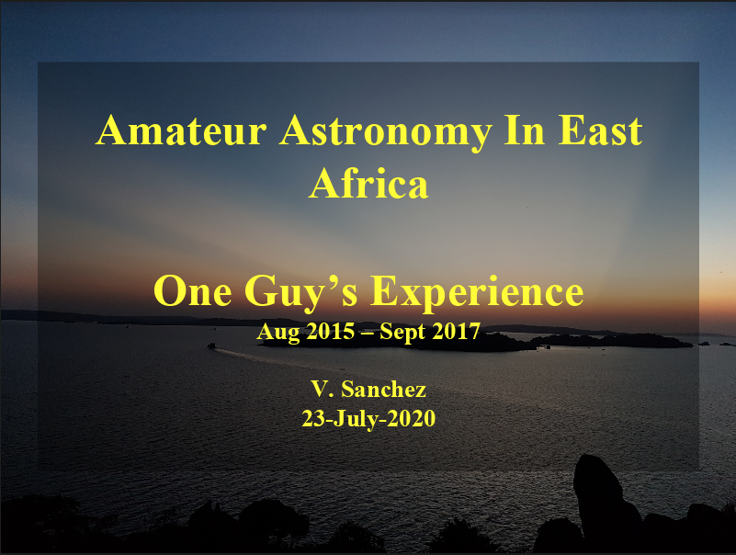
Astro-School Virtual

Slide 23
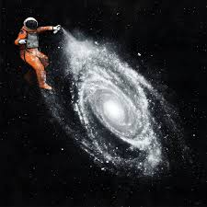
HAL Members Astro Art

Slide 24
List of Great Comets
Unnamed – 373–372 BC
Halley's Comet – 87 BC
Caesar's Comet – 44 BC
Halley's Comet – 12 BC
Halley's Comet – 1066
Great Comet of 1106
Great Comet of 1264
Great Comet of 1402
Great Comet of 1556
Great Comet of 1577
Great Comet of 1618
Great Comet of 1680
Great Comet of 1744
Great Comet of 1811
Great Comet of 1819
Great Comet of 1843
Great Comet of 1844^{[7]}
Donati's Comet – 1858
Great Comet of 1861
Coggia's Comet – 1874
Great Comet of 1882
Great Comet of 1901
Great Daylight Comet of 1910
Halley's Comet – 1910
Comet Skjellerup–Maristany – 1927
Comet Arend–Roland – 1957
Comet Mrkos – 1957
Comet Seki-Lines – 1962
Comet Ikeya–Seki – 1965
Comet Bennett – 1970
Comet Kohoutek – 1973–1974
Comet West – 1976
Comet Hyakutake – 1996
Comet Hale–Bopp – 1997
Comet McNaught – 2007
Comet Neowise – 2020

Slide 25
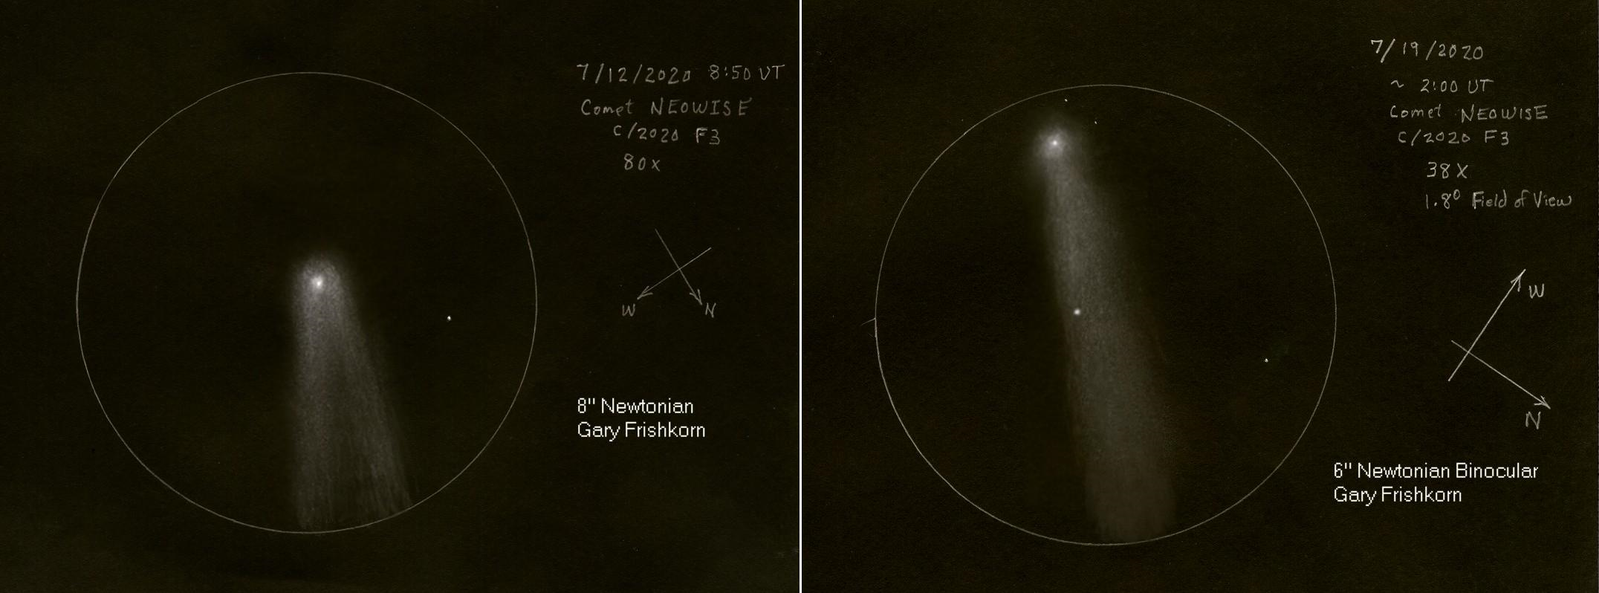

Slide 26
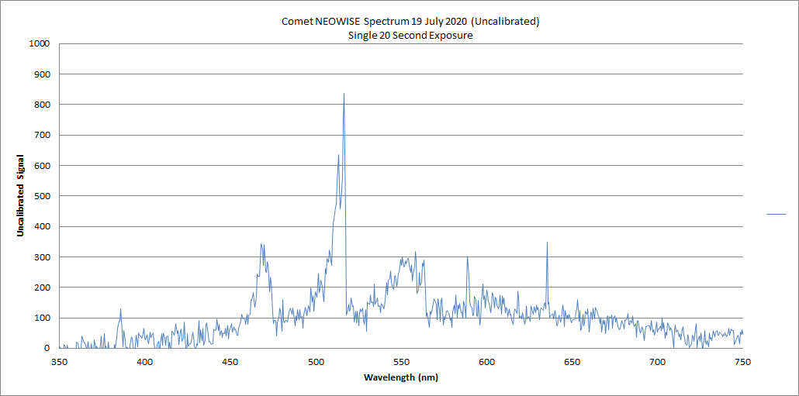
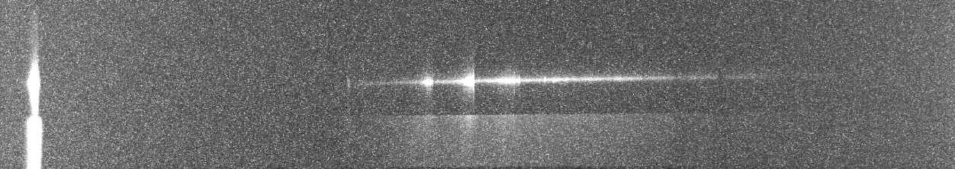
Steve Conard - A single 20 second uncalibrated NEOWISE spectrum collected Saturday night July 18th, at Bear Branch. Telescope used was a C9.25, with reducer operating at f/6.3. Spectrometer was a Shelyak Alpy 600, with an Atik 383L+ camera. You can see the CN line at 388 nm, the C2 bands at ~470 and ~510 nm (these two are the source of the green/blue color), perhaps the OI at ~630 nm (might be a hot pixel), and maybe the sodium line at 589nm
Also including the spectrum directly from the camera, showing zero order on the far left.

Slide 27
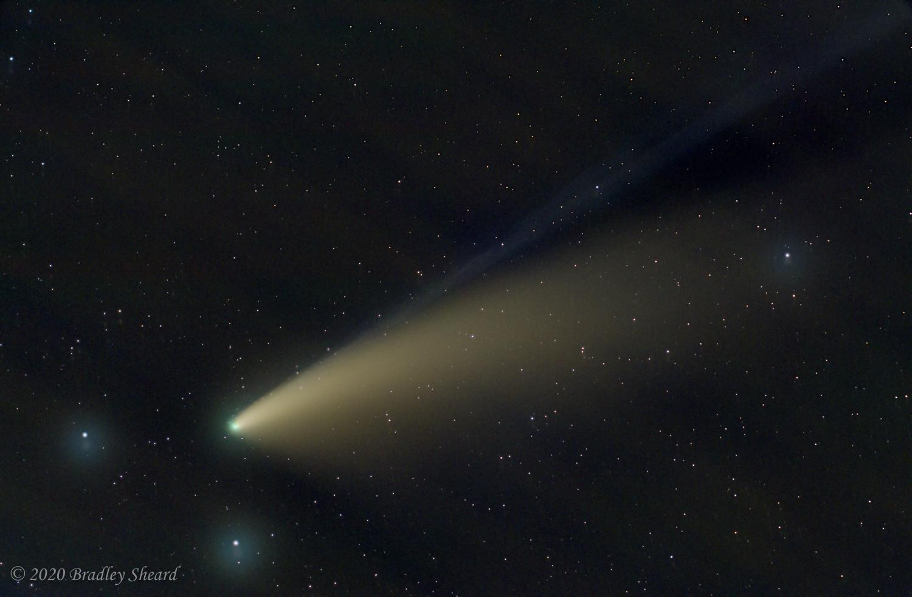
Bradley Sheard

Slide 28
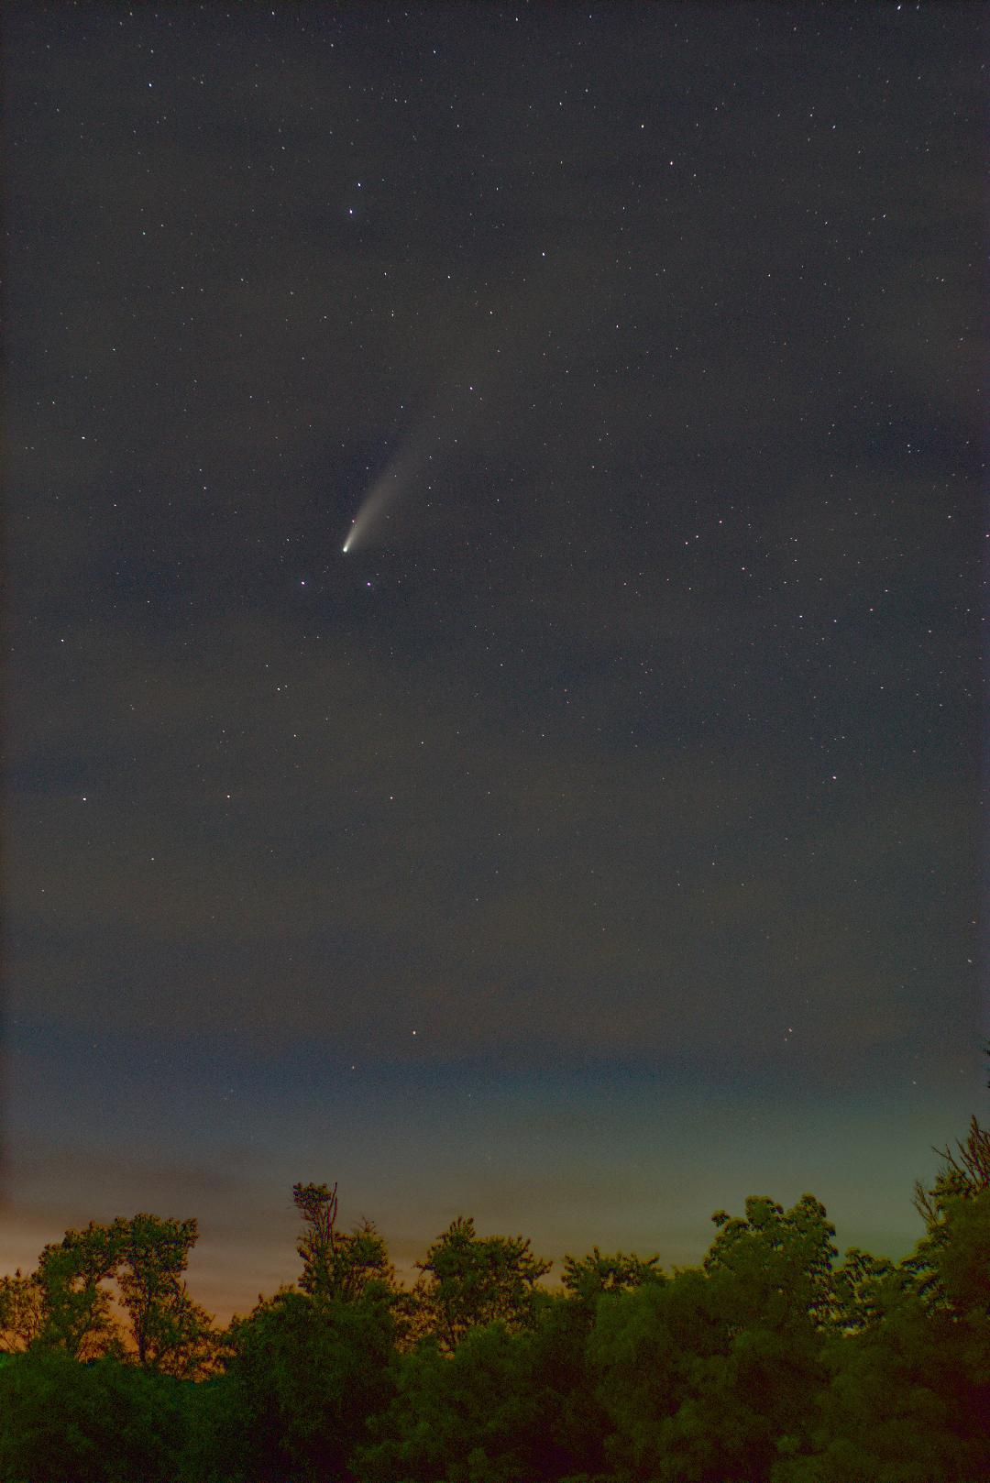
Jim Johnson

Slide 29
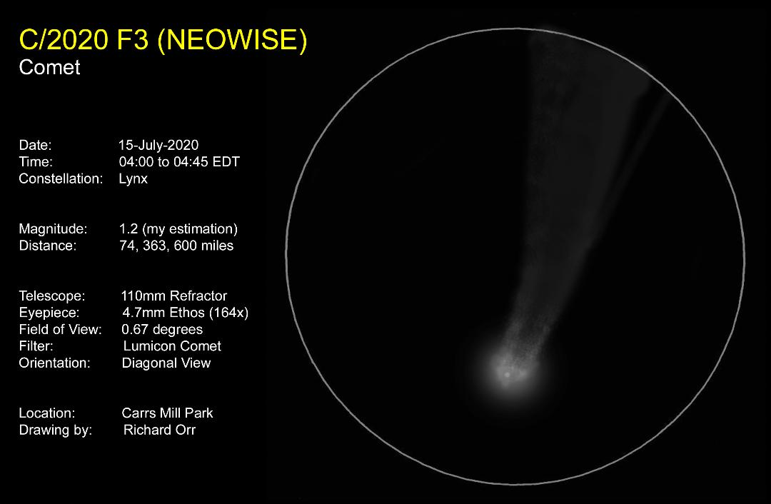
Richard Orr

Slide 30
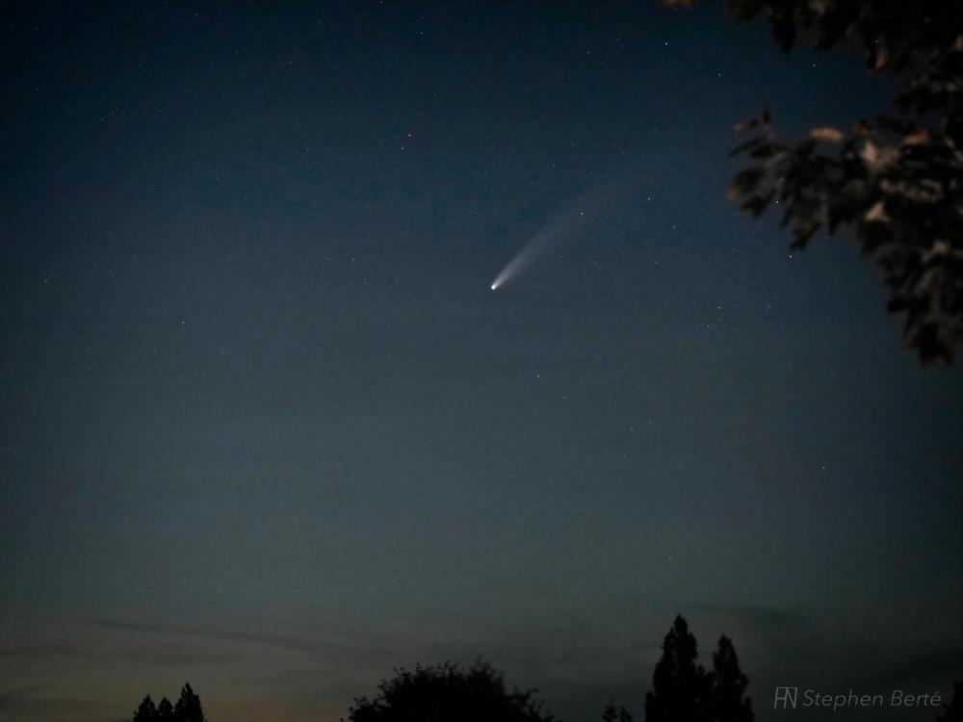
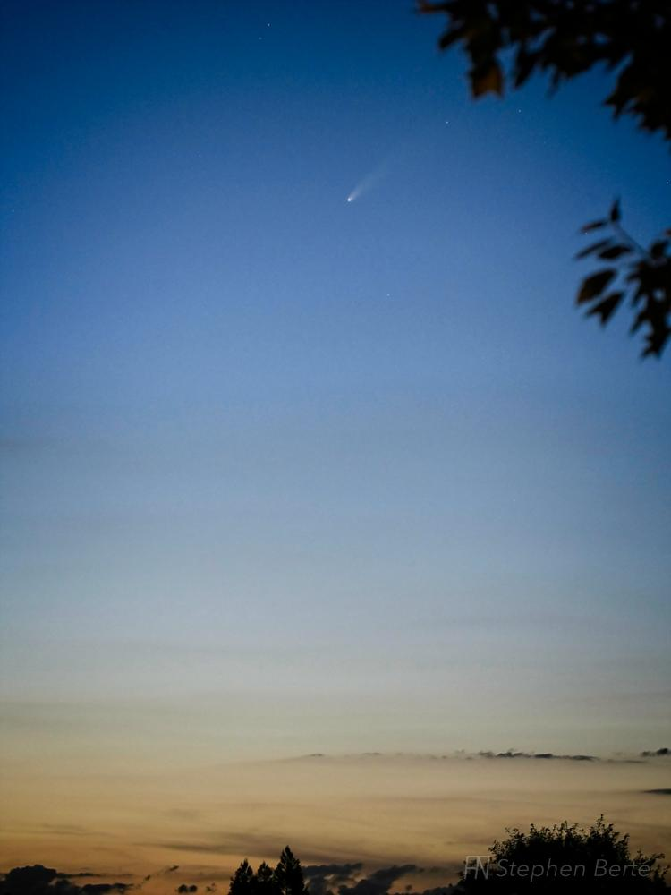
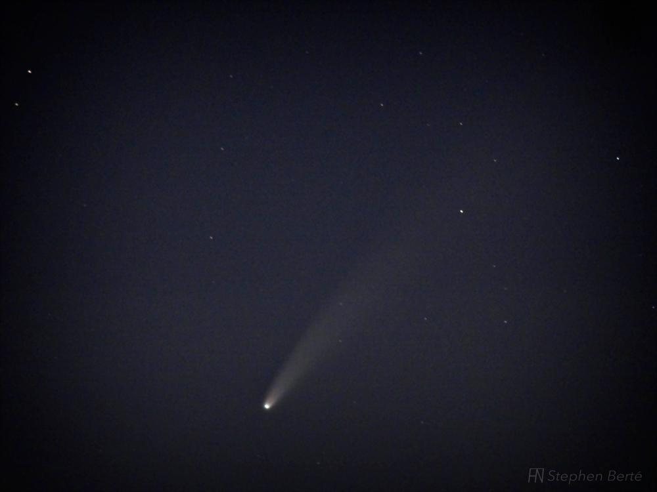
75mm; ISO 2500; 5.0s; f/6.3
94mm; ISO 1250; 3.2s; f/6.3
Steve Berte
300mm; ISO 6400; 4.0s; f/6.7

Slide 31
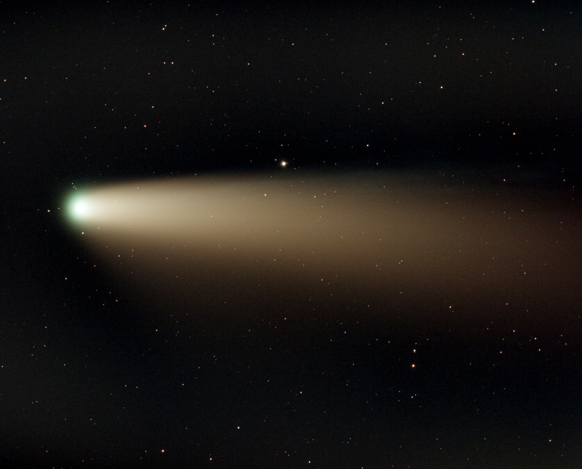
Thorne Ransom

Slide 32
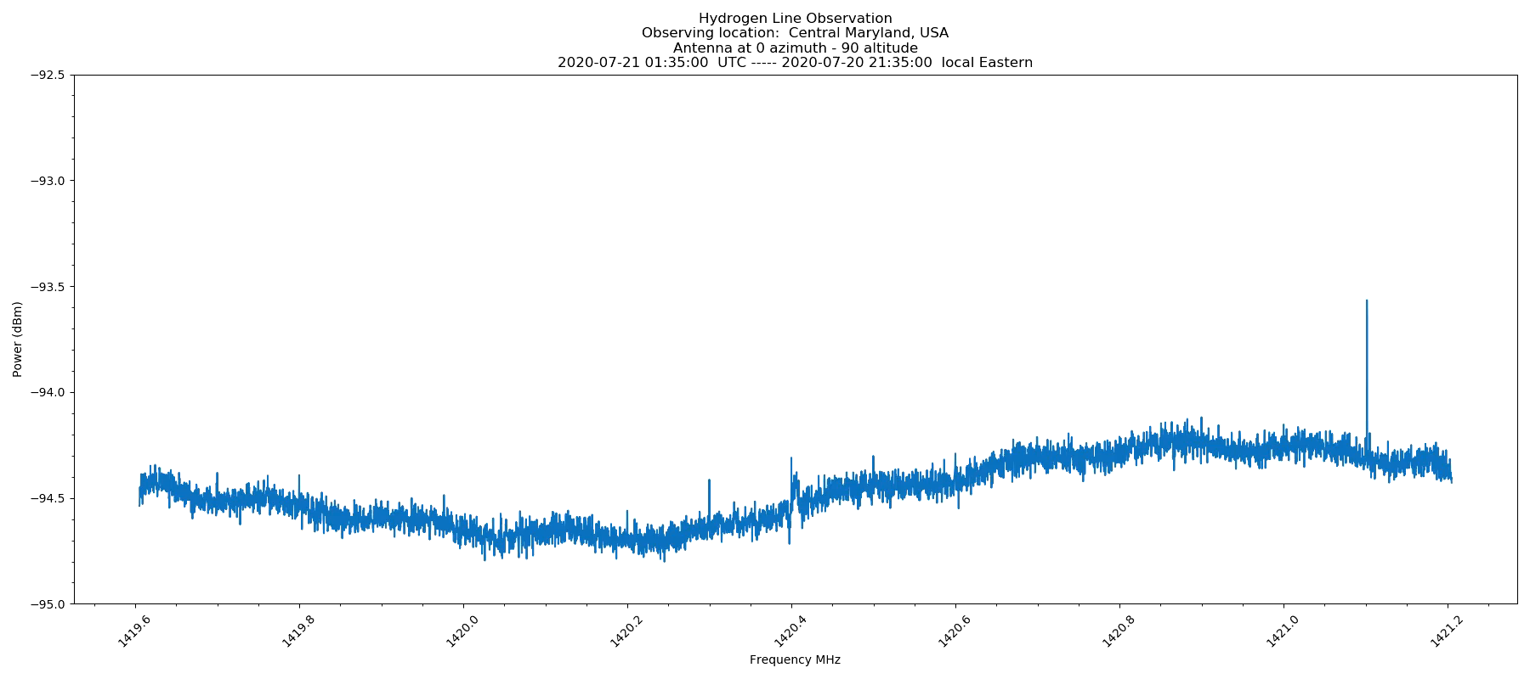
21cm hydrogen line passing overhead twice.
Jim Lane

Slide 33
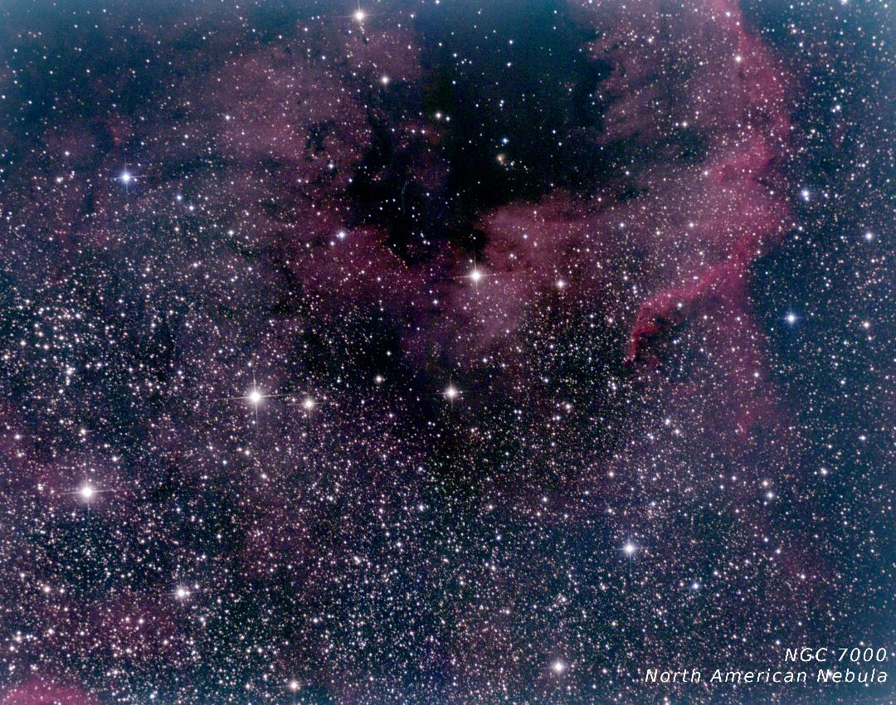
Jim Lane

Slide 34
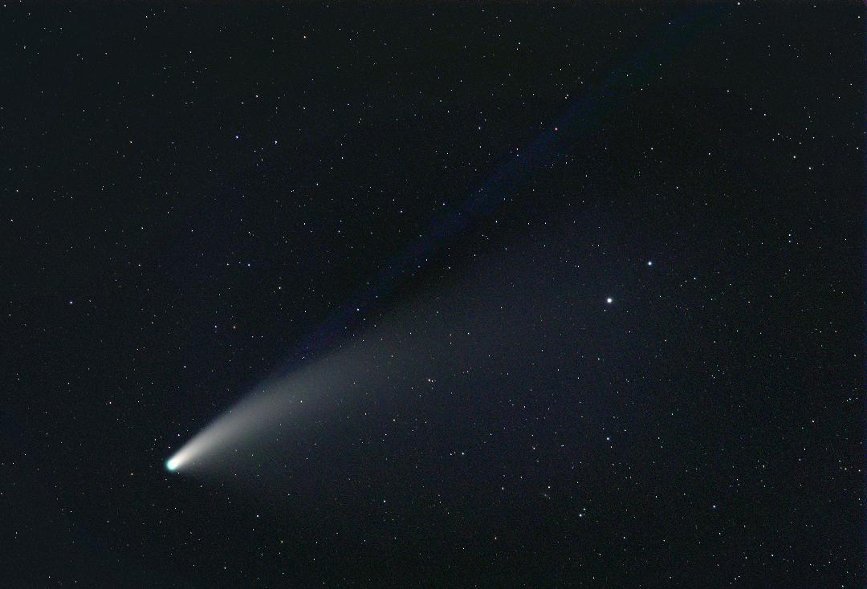
James Willingham

Slide 35
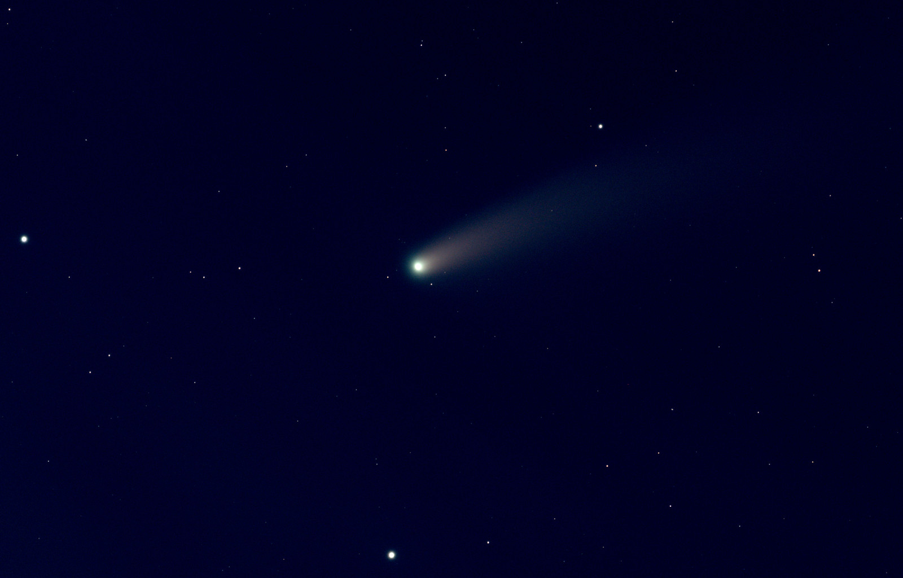
John Nagy

Slide 36
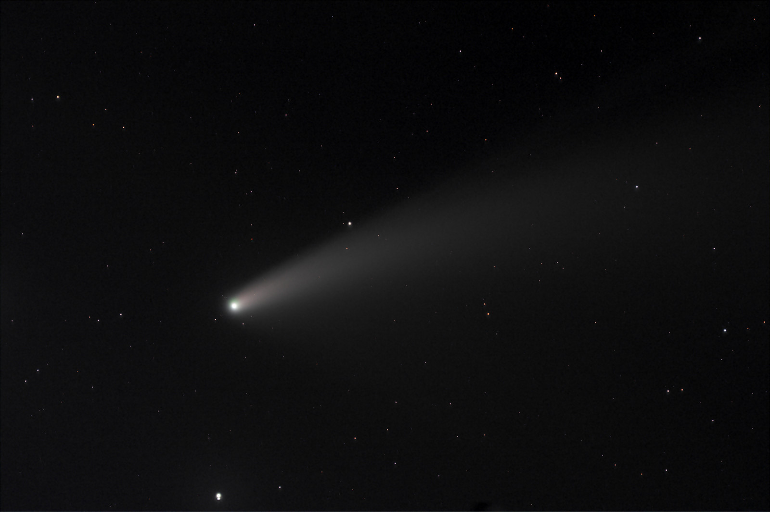
John Nagy

Slide 37
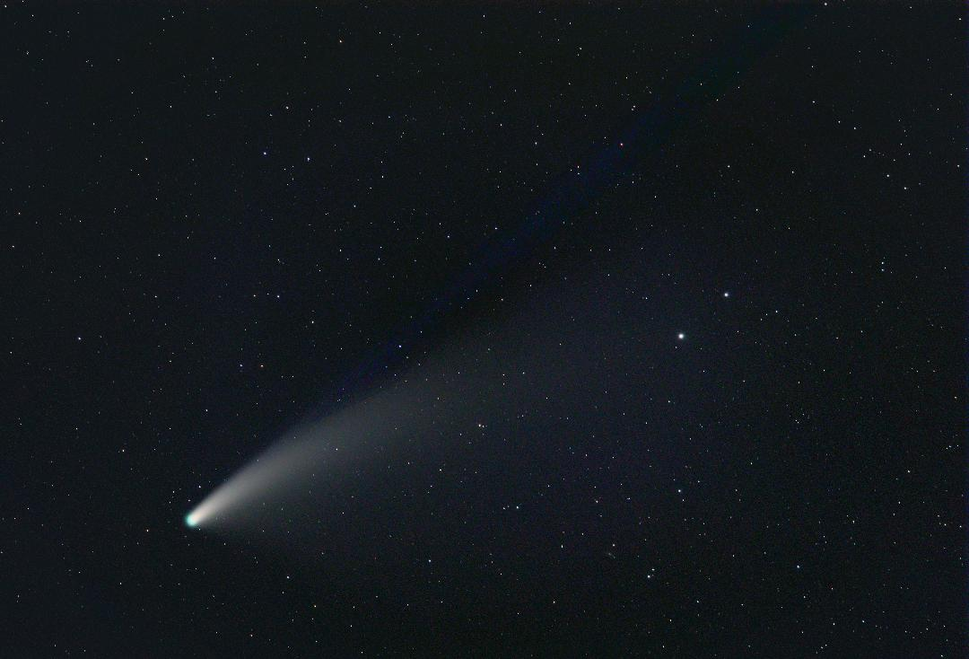
James Willingham

Slide 38
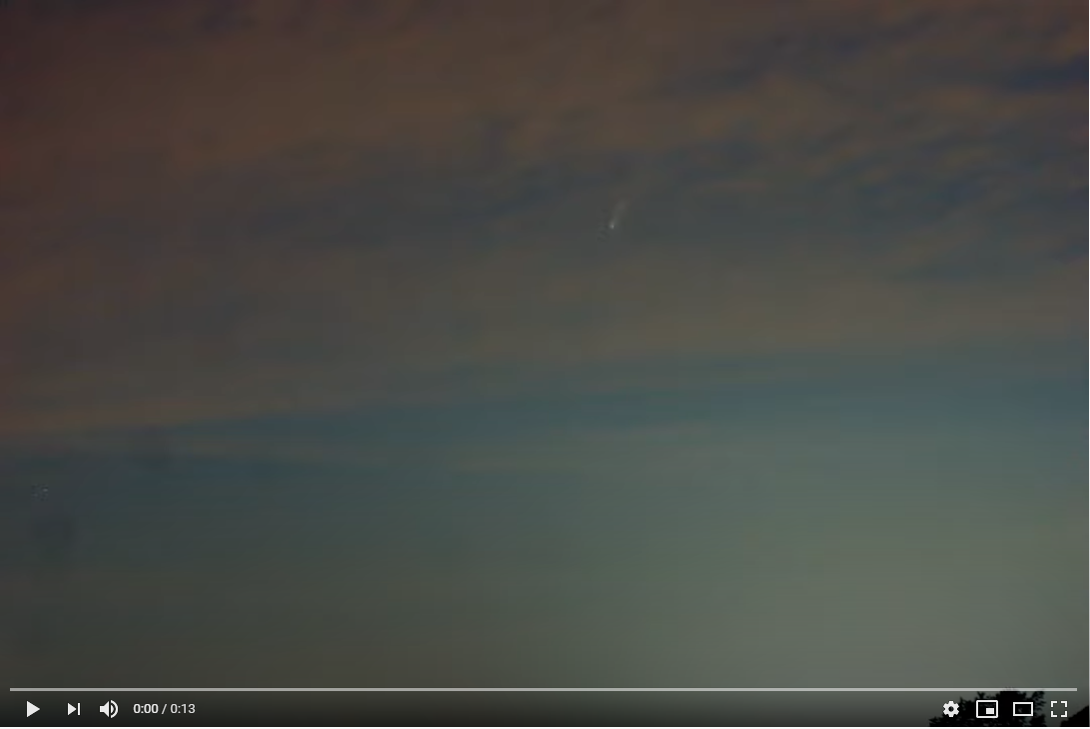
https://www.youtube.com/watch?v=vxyO_x8Nzx0&feature=youtu.be
Victor Sanchez

Slide 39
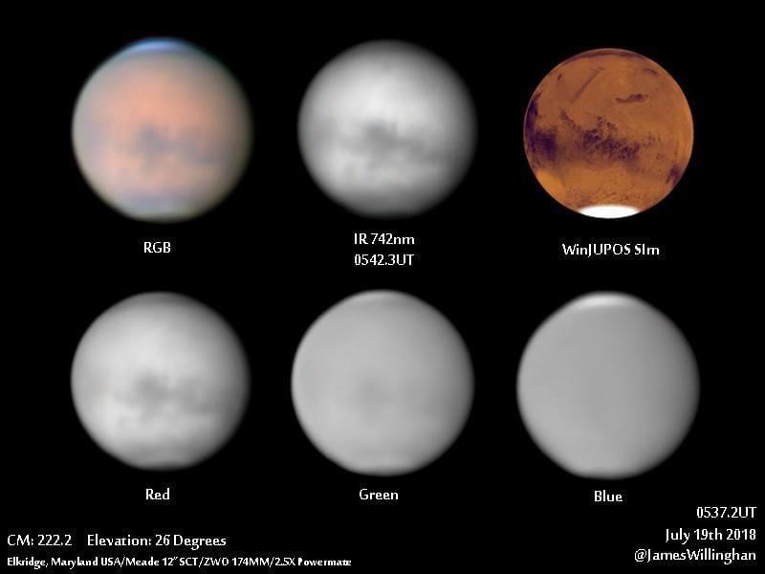
James Willingham – Remembering the Mars Dust Storm

Slide 40
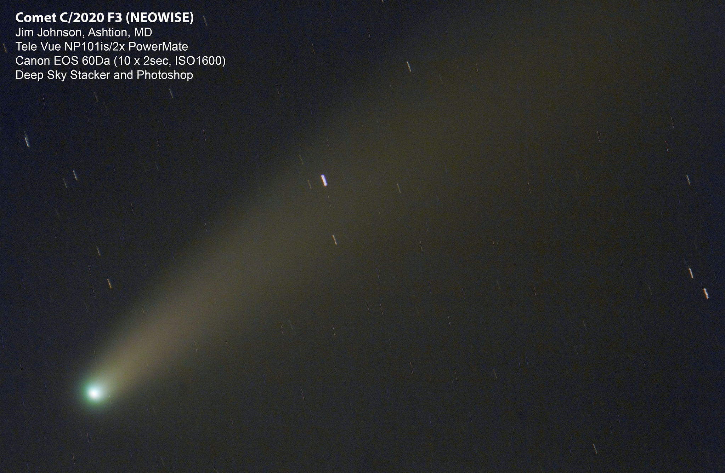
Jim Johnson

Slide 41
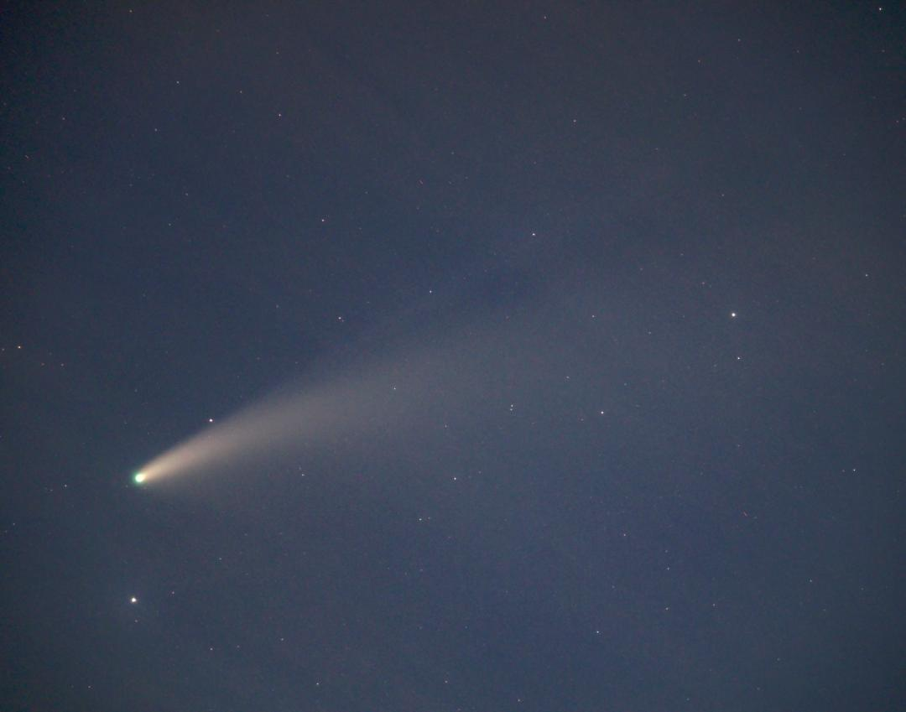
James Willingham

Slide 42
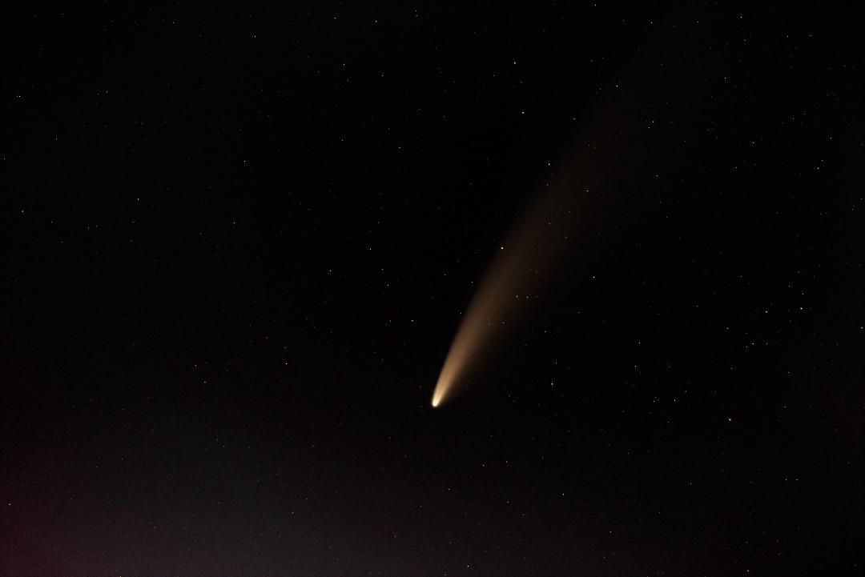
Gene Handler

Slide 43
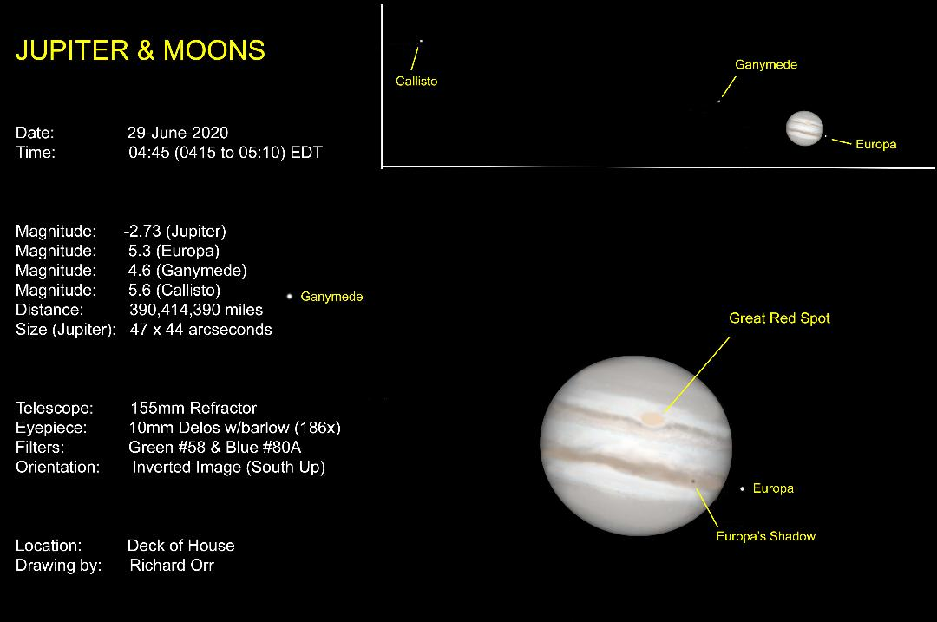
Richard Orr

Slide 44
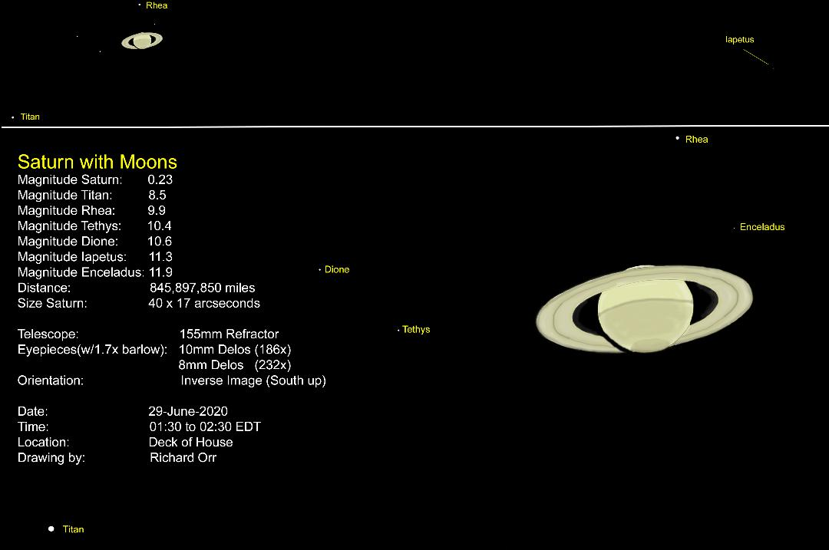
Richard Orr

Slide 45
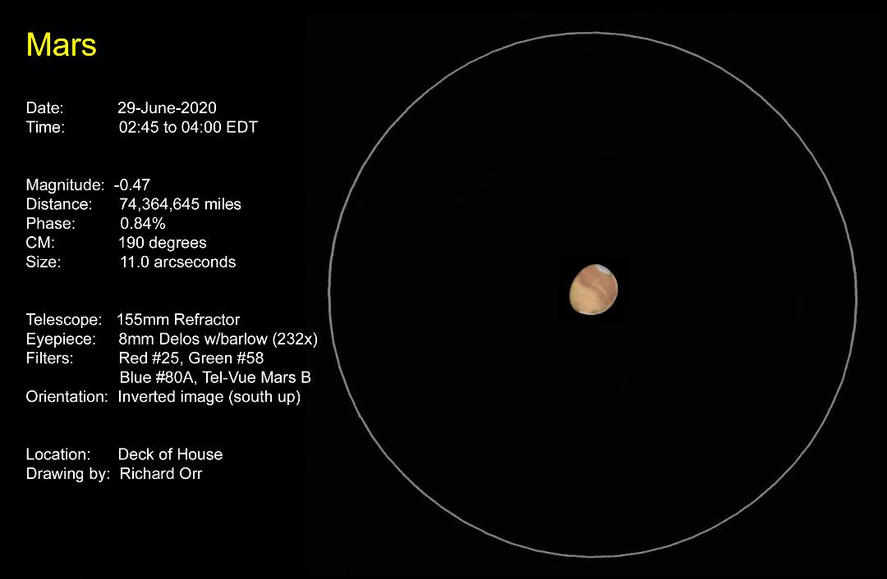
Richard Orr

Slide 46
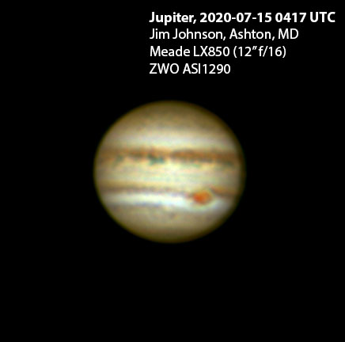
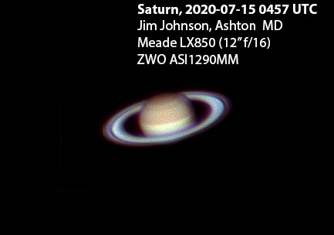
Jim Johnson

Slide 47
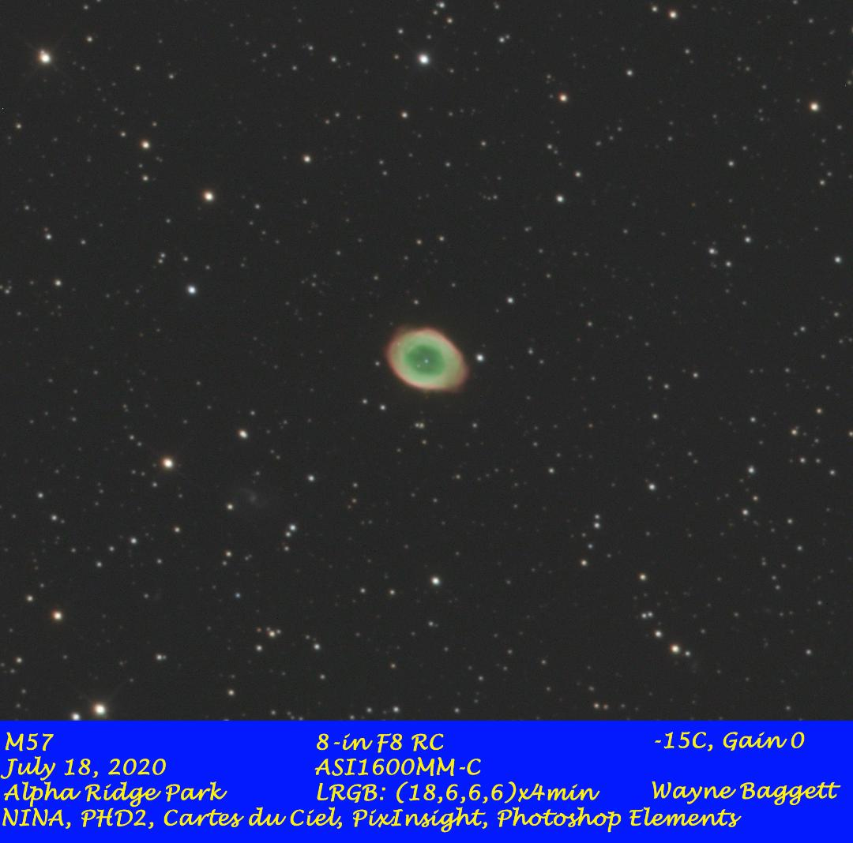

Slide 48
HAL Open Cluster
It is an open forum. The conversation guided itself. Great ideas came from it. Everybody wants to continue on a monthly basis. Next meeting will be soon after July 4th.

Slide 49
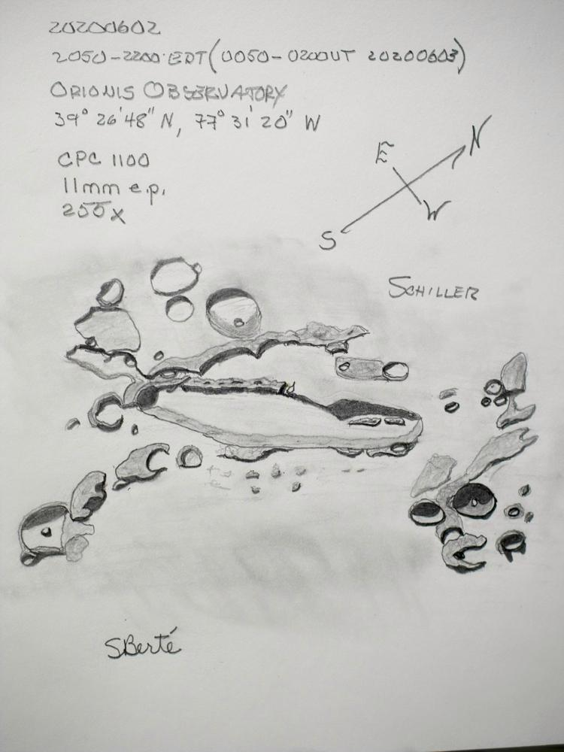
Steve Berte

Slide 50

Steve Berte

Slide 51

Steve Berte

Slide 52

Steve Berte

Slide 53
Name

Slide 54
Name

Slide 55
Name

Slide 56
Thank To All of You
Stay Healthy
Stay Safe
Clear Skies

